Slide 1
Cryptography and Network Security
Fifth Edition by William Stallings
Information Security
Notes:
Lecture slides by Lawrie Brown for “Cryptography and Network Security”, 5/e, by William Stallings, Chapter 22 – “Firewalls”.

Slide 2
Firewalls
The function of a strong position is to make the forces holding it practically unassailable
—On War, Carl Von Clausewitz
Notes:
Opening quote.

Slide 3
Introduction
seen evolution of information systems now everyone want to be on the Internet and to interconnect networks
has persistent security concerns
  can’t easily secure every system in org
typically use a Firewall to provide perimeter defence (the strategies and systems used to protect the outer boundary of a physical space or network, preventing unauthorized access and detecting threats) as part of comprehensive security strategy
Notes:
Information systems in corporations,government agencies,and other organizations have undergone a steady evolution from mainframes to LANs. Internet connectivity is no longer optional, with information and services essential to the organization. Moreover, individual users want and need Internet access. However, while Internet access provides benefits, it enables the outside world to reach and interact with local network assets, creating a threat to the organization. While it is possible to equip each workstation and server on the premises network with strong security features, this is not a practical approach in general. Firewalls can be an effective means of protecting a local system or network of systems from network-based security threats while at the same time affording access to the outside world via wide area networks and the Internet. However they need to be part of a wider security strategy including host security.

Slide 4
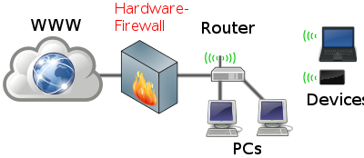
What is a Firewall?
a choke point of control and monitoring interconnects networks with differing trust imposes restrictions on network services
  only authorized traffic is allowed
auditing and controlling access
  Can implement alarms for abnormal behavior
provide NAT & usage monitoring implement VPNs using IPSec must be immune to penetration
Network Address Translation (NAT) is a process that translates IP addresses as network packets travel across a router or firewall. It allows multiple devices on a private network to share a single public IP address when accessing the internet, improving security and conserving public IP addresses.
Notes:
A firewall is inserted between the premises network and the Internet to establish a controlled link and to erect an outer security wall or perimeter, forming a single choke point where security and audit can be imposed. A firewall:
defines a single choke point that keeps unauthorized users out of the protected network, prohibits potentially vulnerable services from entering or leaving the network, and provides protection from various kinds of IP spoofing and routing attacks.
2. provides a location for monitoring security-related events
3. is a convenient platform for several Internet functions that are not security related, such as NAT and Internet usage audits or logs
4. A firewall can serve as the platform for IPSec to implement virtual private networks.
The firewall itself must be immune to penetration, since it will be a target of attack.

Slide 5
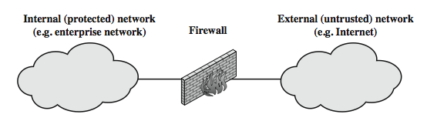
What is a Firewall?
Notes:
Stallings Figure 22.1a illustrates the general model of firewall use on the security perimeter, as a choke point for traffic between between the external less-trusted Internet and the internal more trusted private network.

Slide 6
The Need for Firewalls
Internet connectivity is vital for organizations.
  However, it also poses a threat.
Firewalls are effective for protecting LANs.
  They provide protection at a single point instead of on every computer within the LAN.
Firewalls are placed between the premises network and the Internet to establish a controlled link.
They serve as a perimeter defense.
  Firewalls act as a single choke point to enforce security measures and enable auditing.
  They create insulation between internal systems and external networks.

Slide 7
Firewall Characteristics
Design Goals:
All internal-to-external traffic is routed through the firewall.
Only authorized traffic, as per the local security policy, is permitted to pass through.
The firewall is impervious (immune) to penetration attempts.
General Techniques:
Service control: Filtering based on IP address and port number.
Direction control: Controlling traffic flow to and from the internal LAN and external Internet.
User control: Managing access based on user categorization (e.g., student vs. faculty).
Behavior control: Filtering emails to identify and block spam.

Slide 8
Firewall Limitations
Cannot protect from attacks bypassing it: Firewalls can't stop attacks that use alternative routes, like:
  Sneaker net: physically bringing in infected devices.
  Utility modems: using modems to bypass the firewall.
  Trusted organizations: attacks from within trusted networks.
Trusted services: exploiting secure protocols like SSL/SSH.
  Cannot protect against internal threats: Firewalls can't defend against:
  Disgruntled employees: insider attacks from unhappy staff.
  Colluding employees: coordinated attacks from multiple insiders.
Cannot protect against access via WLAN: Firewalls can't prevent unauthorized access through:
  Unsecured Wi-Fi networks: if WLAN is not properly secured.
Cannot protect against malware imported via laptop, PDA, storage infected outside: Firewalls can't stop malware brought in through:
  Infected laptops or PDAs: devices infected outside the network.
  Infected storage devices: USB drives or other storage media infected outside.
Notes:
Firewalls have their limitations, including that they:
1. cannot protect against attacks that bypass the firewall, eg PCs with dial-out capability to an ISP, or dial-in modem pool use
2. do not protect against internal threats, eg disgruntled employee or one who cooperates with an attacker
3. An improperly secured wireless LAN may be accessed from outside the organization. An internal firewall that separates portions of an enterprise network cannot guard against wireless communications between local systems on different sides of the internal firewall.
4. A laptop, PDA, or portable storage device may be used and infected outside the corporate network, and then attached and used internally.

Slide 9
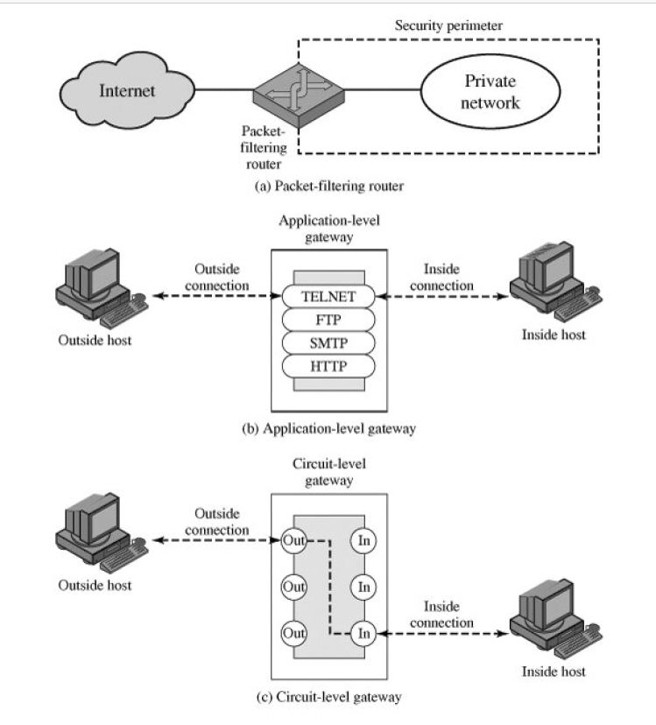
Types of Firewalls

Slide 10
Firewalls – Packet Filters
Simplest and Fastest Firewall Component:
Packet filters are the most basic and efficient type of firewall. They operate at the network layer of the OSI model, examining each IP packet individually without considering the context of the packet's contents.
Foundation of Any Firewall System:
Packet filters serve as the foundation for more complex firewall systems. They provide a basic level of security by controlling incoming and outgoing network traffic based on predetermined rules
Access Restriction:
Packet filters can restrict access to services based on ports. For example:
  Blocking incoming traffic on port 80 (HTTP) to prevent web access
  Allowing outgoing traffic on port 25 (SMTP) for email sendings
Default Policies: There are two possible default policies for packet filters:
  That Not Expressly Permitted Is Prohibited: This policy implies that any action not explicitly allowed is automatically prohibited. For example:
    A company may block all incoming traffic by default, only allowing specific IP addresses or ports.
  That Not Expressly Prohibited Is Permitted: Conversely, this policy suggests that any action not explicitly forbidden is permitted by default. For example:
    A home network may allow all outgoing traffic by default, only blocking specific IP addresses or ports.
Notes:
Have three common types of firewalls: packet filters, application-level gateways, & circuit-level gateways.
A packet-filtering router applies a set of rules to each incoming and outgoing IP packet to forward or discard the packet. Filtering rules are based on information contained in a network packet such as src & dest IP addresses, ports, transport protocol & interface. Some advantages are simplicity, transparency & speed.
If there is no match to any rule, then one of two default policies are applied:
• that which is not expressly permitted is prohibited (default action is discard packet), conservative policy
• that which is not expressly prohibited is permitted (default action is forward packet), permissive policy

Slide 11
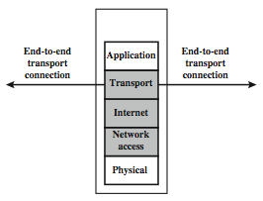
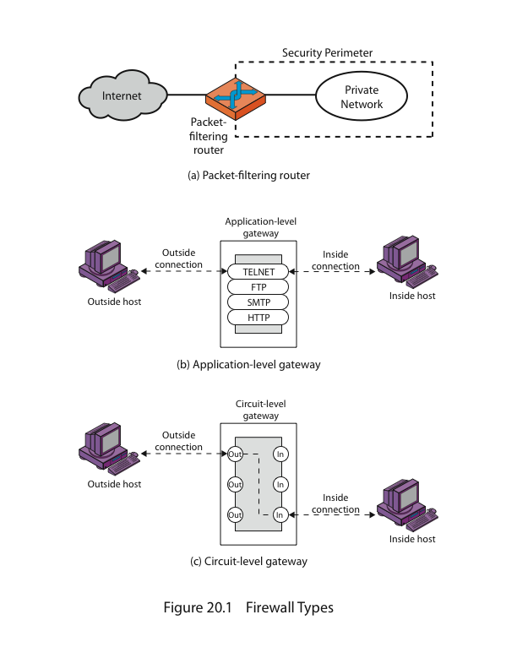
Firewalls – Packet Filters
Notes:
Stallings Figure 22.1b (along with 4/e Figure 20.1a) illustrates the packet filter firewall role as utilising information from the transport, network & data link layers to make decisions on allowable traffic flows, and its placement in the border router between the external less-trusted Internet and the internal more trusted private network.

Slide 12
Attacks on Packet Filters
IP address spoofing
  The intruder transmits packets from the outside with a source IP address field containing an address of an internal host. The attacker hopes that the use of a spoofed address will allow penetration of systems that employ simple source address security, in which packets from specific trusted internal hosts are accepted. The countermeasure is to discard packets with an inside source address if the packet arrives on an external interface.
source routing attacks
  The source station specifies the route that a packet should take as it crosses the Internet, in the hopes that this will bypass security measures that do not analyze the source routing information. The countermeasure is to discard all packets that use this option.
tiny fragment attacks
  An attacker uses IP fragmentation to split packets into tiny fragments, separating the TCP header info from the rest of the packet. This can bypass filtering rules that rely on TCP header info, as some routers only examine the first fragment. To prevent this "tiny fragment attack," routers can enforce a rule requiring a minimum amount of transport header data in the first fragment, and then block subsequent fragments if the first one is rejected.
Notes:
Some of the attacks that can be made on packet-filtering routers & countermeasures are:
• IP address spoofing: where intruder transmits packets from the outside with internal host source IP addr, need to filter & discard such packets
• Source routing attacks: where source specifies the route that a packet should take to bypass security measures, should discard all source routed packets
• Tiny fragment attacks: intruder uses the IP fragmentation option to create extremely small fragments and force the TCP header information into a separate fragments to circumvent filtering rules needing full header info, can enforce minimum fragment size to include full header.

Slide 13
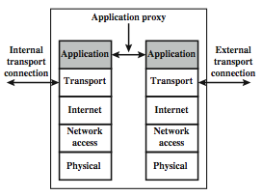
Firewalls - Application Level Gateway (or Proxy)
Notes:
Stallings Figure 22.1d (along with 4/e Figure 20.1b) illustrates an application-level gateway (or proxy server), emphasizing that it only supports a specific list of application services.

Slide 14
Firewalls - Application Level Gateway (or Proxy)
An application-level gateway, also called a proxy server, acts as a relay of application-level traffic
The user contacts the gateway using a TCP/IP application, such as Telnet or FTP, and the gateway asks the user for the name of the remote host to be accessed. When the user responds and provides a valid user ID and authentication information, the gateway contacts the application on the remote host and relays TCP segments containing the application data between the two endpoints. If the gateway does not implement the proxy code for a specific application, the service is not supported and cannot be forwarded across the firewall. Further, the gateway can be configured to support only specific features of an application that the network administrator considers acceptable while denying all other features.
Application-level gateways tend to be more secure than packet filters. Rather than trying to deal with the numerous possible combinations that are to be allowed and forbidden at the TCP and IP level, the application-level gateway need only scrutinize a few allowable applications.
Notes:
An application-level gateway (or proxy server), acts as a relay of application-level traffic. A user contacts the gateway to access some service, provides details of the service, remote host & authentication details, contacts the application on the remote host and relays all data between the two endpoints. If the gateway does not implement the proxy code for a specific application, then it is not supported and cannot be used. Note that some services naturally support proxying, whilst others are more problematic. Application-level gateways tend to be more secure than packet filters, &can log and audit traffic at application level.

Slide 15
Firewalls - Circuit Level Gateway
This can be a stand-alone system or it can be a specialized function performed by an application-level gateway for certain applications. A circuit-level gateway does not permit an end-to-end TCP connection; rather, the gateway sets up two TCP connections, one between itself and a TCP user on an inner host and one between itself and a TCP user on an outside host.
Once the two connections are established, the gateway typically relays TCP segments from one connection to the other without examining the contents. The security function consists of determining which connections will be allowed.
Notes:
A fourth type of firewall is the circuit-level gateway or circuit-level proxy. This can be a stand-alone system or it can be a specialized function performed by an application-level gateway for certain applications. A circuit-level gateway relays two TCP connections, one between itself and an inside TCP user, and the other between itself and a TCP user on an outside host. Once the two connections are established, it relays TCP data from one connection to the other without examining its contents. The security function consists of determining which connections will be allowed. It is typically used when internal users are trusted to decide what external services to access.
One of the most common circuit-level gateways is SOCKS, defined in RFC 1928. It consists of a SOCKS server on the firewall, and a SOCKS library & SOCKS-aware applications on internal clients. When a TCP-based client wishes to establish a connection to an object that is reachable only via a firewall (such determination is left up to the implementation), it must open a TCP connection to the appropriate SOCKS port on the SOCKS server system. If the connection request succeeds, the client enters a negotiation for the authentication method to be used, authenticates with the chosen method, and then sends a relay request. The SOCKS server evaluates the request and either establishes the appropriate connection or denies it. UDP exchanges are handled in a similar fashion.

Slide 16
An example of a circuit-level gateway implementation is the SOCKS package version 5 of SOCKS is defined in RFC 1928. The RFC defines SOCKS in the following fashion:
The protocol described here is designed to provide a framework for client-server applications in both the TCP and UDP(User Datagram Protocol) domains to conveniently and securely use the services of a network firewall. The protocol is conceptually a "shim-layer" between the application layer and the transport layer, and as such does not provide network-layer gateway services, such as forwarding of ICMP(Internet Control Message Protocol) messages.
When a TCP-based client wishes to establish a connection to an object that is reachable only via a firewall (such determination is left up to the implementation), it must open a TCP connection to the appropriate SOCKS port on the SOCKS server system. The SOCKS service is located on TCP port 1080.
If the connection request succeeds, the client enters a negotiation for the authentication method to be used, authenticates with the chosen method, and then sends a relay request. The SOCKS server evaluates the request and either establishes the appropriate connection or denies it. UDP exchanges are handled in a similar fashion. In essence, a TCP connection is opened to authenticate a user to send and receive UDP segments, and the UDP segments are forwarded as long as the TCP connection is open.

Slide 17
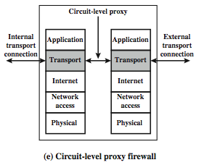
Firewalls - Circuit Level Gateway
Notes:
Stallings Figure 22.1e (along with 4/e Figure 20.1c) illustrates a circuit-level gateway, showing how it relays between 2 TCP connections. Note that it can be implemented in a stand-alone system or can be a specialized function in an application-level gateway for certain applications. Note also that relaying UDP packets is more problematical, because of the lack of connection context, and require a parallel TCP connection to provide these details.

Slide 18
Stateful Packet Filters
Traditional packet filters do not examine higher layer context.
  Example: A traditional packet filter might allow incoming traffic on port 80 (HTTP) without checking if the request is part of an existing connection.
Stateful packet filters address this need by examining each IP packet in context.
  Example: A stateful packet filter would check if an incoming packet on port 80 is part of an existing connection initiated by the internal network, ensuring it's a legitimate response to an outgoing request.
Key Features of Stateful Packet Filters
  Keep track of client-server sessions: Stateful packet filters monitor the entire conversation between a client and server.
  Example: If a user initiates a connection to a website, the stateful packet filter tracks the session, allowing incoming packets that are part of this session and blocking others.
Check each packet validly belongs to one: This ensures that packets are not spoofed or out of order.
  Example: If a packet claims to be part of a session but doesn't match the expected sequence number, the stateful packet filter would block it.
Hence are better able to detect bogus packets out of context: By understanding the context of packets, stateful packet filters can identify and block malicious traffic more effectively.
  Example: A stateful packet filter can detect and block a SYN flood attack, where an attacker sends a large number of TCP SYN packets to overwhelm a system, because it recognizes these packets are not part of any legitimate session.
May even inspect limited application data: Some stateful packet filters can look into the application layer data to some extent.
  Example: A stateful packet filter might inspect HTTP requests to ensure they conform to expected formats and do not contain malicious payloads.
Notes:
A traditional packet filter makes filtering decisions on an individual packet basis and does not take into consideration any higher layer context. In general, when an application that uses TCP creates a session with a remote host, it creates a TCP connection in which the TCP port number for the remote (server) application is a number less than 1024 and the TCP port number for the local (client) application is a number between 1024 and 65535. A simple packet filtering firewall must permit inbound network traffic on all these high- numbered ports for TCP-based traffic to occur. This creates a vulnerability that can be exploited by unauthorized users. A stateful inspection packet filter tightens up the rules for TCP traffic by creating a directory of outbound TCP connections, and will allow incoming traffic to high-numbered ports only for those packets that fit the profile of one of the entries in this directory. Hence they are better able to detect bogus packets sent out of context. A stateful packet inspection firewall reviews the same packet information as a packet filtering firewall, but also records information about TCP connections. Some stateful firewalls also keep track of TCP sequence numbers to prevent attacks that depend on the sequence number, such as session hijacking. Some even inspect limited amounts of application data for some well-known protocols like FTP, IM and SIPS commands, in order to identify and track related connections.

Slide 19
Bastion Host
Key Characteristics of a Bastion Host:
Highly Secure Host System: A bastion host is a hardened system that has been configured to be highly secure. This means that it has been stripped of any unnecessary services or applications, and only the essential services are running.
Runs Circuit/Application Level Gateways: A bastion host can run circuit-level gateways or application-level gateways.
Provides Externally Accessible Services: A bastion host can provide externally accessible services such as web servers, email servers, or FTP servers.
Potentially Exposed to Hostile Elements: Since a bastion host is exposed to the internet, it is potentially vulnerable to attacks from hostile elements such as hackers, malware, or denial-of-service (DoS) attacks.
Secured to Withstand Attacks: To mitigate these risks, a bastion host is secured to withstand attacks. This includes hardening the operating system, running only essential services, and implementing additional authentication mechanisms.
Proxies Small, Secure, Independent, Non-Privileged: A bastion host can act as a proxy server, which means that it can forward requests from clients to servers on the private network.
May Support 2 or More Net Connections: A bastion host may support two or more network connections, which allows it to connect to multiple networks simultaneously.
May Be Trusted to Enforce Policy of Trusted Separation: A bastion host may be trusted to enforce the policy of trusted separation between networks. This means that it can control access to the private network and ensure that only authorized traffic is allowed to pass through.
Examples of Bastion Hosts: webserver, email server, VPN
Notes:
It is common to base a firewall on a stand-alone machine running a common operating system, such as UNIX or Linux. Firewall functionality can also be implemented as a software module in a router or LAN switch.
A bastion host is a critical strong point in the network’s security, serving as a platform for an application-level or circuit-level gateway, or for external services. It is thus potentially exposed to "hostile" elements and must be secured to withstand this. Common characteristics of a bastion host include that it:
• executes a secure version of its O/S, making it a trusted system
• has only essential services installed on the bastion host
• may require additional authentication before a user may access to proxy services
• configured to use only subset of standard commands, access only specific hosts
• maintains detailed audit information by logging all traffic
• each proxy module a very small software package designed for network security
• has each proxy independent of other proxies on the bastion host
• have a proxy performs no disk access other than read its initial configuration file
• have each proxy run as a non-privileged user in a private and secured directory
A bastion host may have two or more network interfaces (or ports), and must be trusted to enforce trusted separation between these network connections, relaying traffic only according to policy.

Slide 20
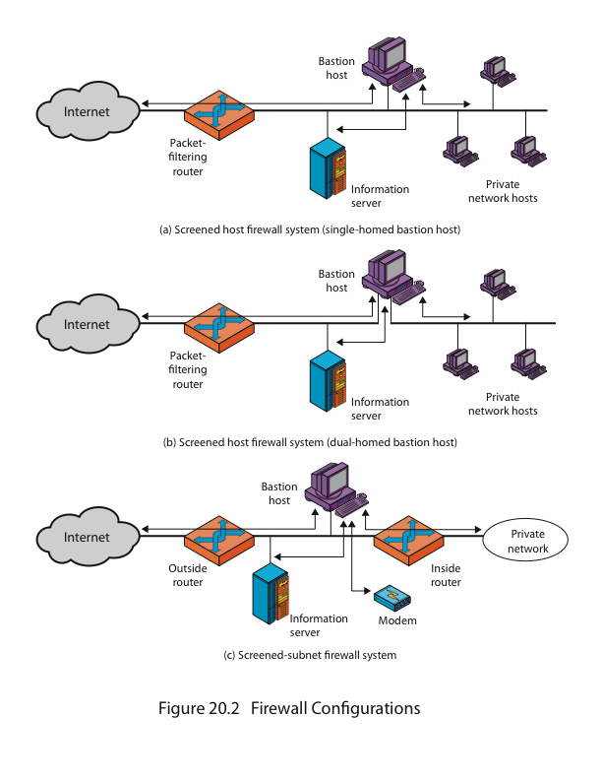
Firewall Configurations
The packet-filtering router is the first line of defense against external threats.
The bastion host is a single point of entry for incoming traffic from the internet.
The information server is protected by the bastion host and packet-filtering router.
Private network hosts are not directly accessible from the internet.
Notes:
As Figure 22.1a indicates, a firewall is positioned to provide a protective barrier between an external, potentially untrusted source of traffic and an internal network. With that general principle in mind, a security administrator must decide on the location and on the number of firewalls needed.
In addition to the use of a simple configuration consisting of a single system, more complex configurations are possible and indeed more common. Stallings 4/e Figure 20.2 illustrates three common firewall configurations.
4/e Figure 20.2a shows the “screened host firewall, single-homed bastion configuration”, where the firewall consists of two systems:
a packet-filtering router - allows Internet packets to/from bastion only
a bastion host - performs authentication and proxy functions
This configuration has greater security, as it implements both packet-level & application-level filtering, forces an intruder to generally penetrate two separate systems to compromise internal security, & also affords flexibility in providing direct Internet access to specific internal servers (eg web) if desired.

Slide 21
Firewall Configurations
The screened host firewall, dual-homed bastion configuration physically prevents
such a security breach
Notes:
Stallings 4/e Figure 20.2b illustrates the “screened host firewall, dual-homed bastion configuration” which physically separates the external and internal networks, ensuring two systems must be compromised to breach security. The advantages of dual layers of security are also present here. Again, an information server or other hosts can be allowed direct communication with the router if this is in accord with the security policy, but are now separated from the internal network.

Slide 22
Firewall Configurations
There are now three levels of defense to thwart intruders.
● The outside router advertises only the existence of the screened subnet to the Internet;
therefore, the internal network is invisible to the Internet.
● Similarly, the inside router advertises only the existence of the screened subnet to the internal network; therefore, the systems on the inside network cannot construct direct routes to the
Internet.
Notes:
Stallings 4/e Figure 20.2c shows the “screened subnet firewall configuration”, being the most secure shown. It has two packet-filtering routers, one between the bastion host and the Internet and the other between the bastion host and the internal network, creating an isolated subnetwork. This may consist of simply the bastion host but may also include one or more information servers and modems for dial-in capability. Typically, both the Internet and the internal network have access to hosts on the screened subnet, but traffic across the screened subnet is blocked.
This configuration offers several advantages:
• There are now three levels of defense to thwart intruders
• The outside router advertises only the existence of the screened subnet to the Internet; therefore the internal network is invisible to the Internet
• Similarly, the inside router advertises only the existence of the screened subnet to the internal network; hence systems on the inside network cannot construct direct routes to the Internet

Slide 23
Host-Based Firewalls
Host-based firewalls are software modules designed to secure individual hosts, such as computers or servers. They are available in many operating systems or can be provided as an add-on package.
Key Features and Advantages:
  Software Module: Host-based firewalls are software modules that run on individual hosts.
  Availability: They are available in many operating systems or can be provided as an add-on package.
  Common Use: Often used on servers to provide an additional layer of protection.
Advantages of Host-Based Firewalls:
  Tailored Filtering Rules: Host-based firewalls can tailor filtering rules to the host environment, allowing for more specific and effective security measures.
  Independent Protection: Protection is provided independent of topology, meaning that the firewall's effectiveness is not dependent on the network architecture.
  Additional Layer of Protection: Host-based firewalls provide an additional layer of protection, enhancing the overall security of the host.
Examples:
  Windows Defender Firewall: A built-in host-based firewall in Windows operating systems that allows users to control incoming and outgoing network traffic.
  iptables: A host-based firewall for Linux systems that enables users to configure rules for incoming and outgoing network traffic.
  pfSense: A free and open-source host-based firewall that can be installed on a computer or virtual machine to provide advanced security features.
Notes:
A host-based firewall is a software module used to secure an individual host. Such modules are available in many operating systems or can be provided as an add-on package. Like conventional stand-alone firewalls, host-resident firewalls filter and restrict the flow of packets. A common location for such firewalls is a server. There are several advantages to the use of a server-based or workstation-based firewall:
• Filtering rules can be tailored to the host environment. Specific corporate security policies for servers can be implemented, with different filters for servers used for different application.
• Protection is provided independent of topology. Thus both internal and external attacks must pass through the firewall.
• Used in conjunction with stand-alone firewalls, the host-based firewall provides an additional layer of protection. A new type of server can be added to the network, with its own firewall, without the necessity of altering the network firewall configuration.

Slide 24
Personal Firewalls
controls traffic between PC/workstation and Internet or enterprise network
a software module on personal computer or in home/office DSL/cable/ISP router
typically much less complex than other firewall types
primary role to deny unauthorized remote access to the computer and monitor outgoing activity for malware
Examples of Personal Firewalls:
  Windows Defender Firewall:
  Norton Personal Firewall:
  GlassWire Firewall:.
Notes:
A personal firewall controls the traffic between a personal computer or workstation on one side and the Internet or enterprise network on the other side. Personal firewall functionality can be used in the home environment and on corporate intranets. Typically, the personal firewall is a software module on the personal computer. In a home environment with multiple computers connected to the Internet, firewall functionality can also be housed in a router that connects all of the home computers to a DSL, cable modem, or other Internet interface.
Personal firewalls are typically much less complex than either server-based firewalls or stand-alone firewalls. The primary role of the personal firewall is to deny unauthorized remote access to the computer. The firewall can also monitor outgoing activity in an attempt to detect and block worms and other malware.

Slide 25
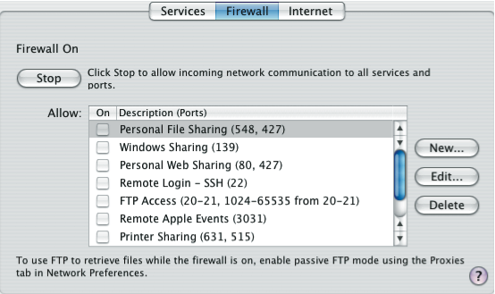
Personal Firewalls
Notes:
An example of a personal firewall is the capability built in to the Mac OS X operating system. When the user enables the personal firewall in Mac OS X, all inbound connections are denied except for those the user explicitly permits. Stallings Figure 22.2 shows this simple interface. There is a list of inbound services that can be selectively re-enabled, with their port numbers. For increased protection, advanced firewall features are available through easy-to- configure checkboxes. Stealth mode hides the Mac on the Internet by dropping unsolicited communication packets, making it appear as though no Mac is present. UDP packets can be blocked, restricting network traffic to TCP packets only for open ports. The firewall also supports logging, an important tool for checking on unwanted activity.
Similar features are provided by the firewalls provided in Windows and Linux systems.

Slide 26
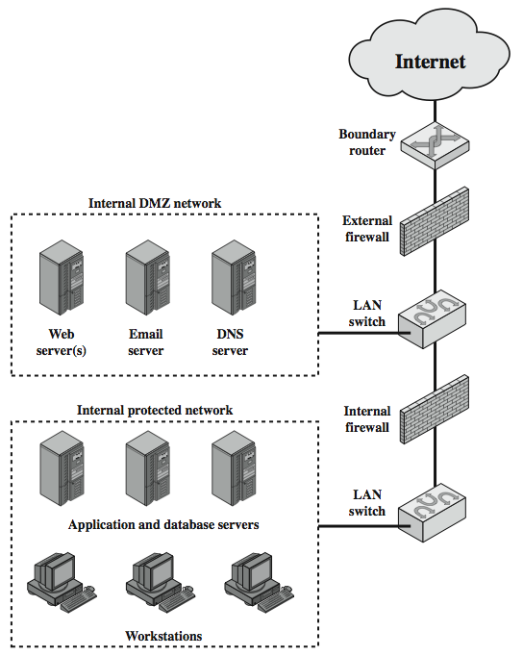
DMZ Networks
Notes:
Stallings Figure 22.3 further illustrates the use of a “screened subnet”, also known as a demilitarized zone (DMZ), located between an internal and an external firewall. An external firewall is placed at the edge of a local or enterprise network, just inside the boundary router that connects to the Internet or some wide area network (WAN). One or more internal firewalls protect the bulk of the enterprise network. Systems that are externally accessible but need some protections are usually located on DMZ networks. Typically, the systems in the DMZ require or foster external connectivity, such as a corporate Web site, an e-mail server, or a DNS (domain name system) server. The external firewall provides a measure of access control and protection for the DMZ systems consistent with their need for external connectivity. The external firewall also provides a basic level of protection for the remainder of the enterprise network. In this type of configuration, internal firewalls serve three purposes:
The internal firewall adds more stringent filtering capability, vs the external firewall, to protect enterprise servers and workstations from external attack.
The internal firewall provides two-way protection with respect to the DMZ, as it protects the remainder of the network from attacks launched from DMZ systems, and protects DMZ systems from attack by internal hosts.
Multiple internal firewalls can be used to protect portions of the internal network from each other.
A common practice is to place the DMZ on a different network interface on the external firewall from that used to access the internal networks.

Slide 27
a “screened subnet”, also known as a demilitarized zone (DMZ), located between an internal and an external firewall.
An external firewall is placed at the edge of a local or enterprise network, just inside the boundary router that connects to the Internet or some wide area network (WAN). One or more internal firewalls protect the bulk of the enterprise network.
Systems that are externally accessible but need some protections are usually located on DMZ networks. Typically, the systems in the DMZ require or foster external connectivity, such as a corporate Web site, an e-mail server, or a DNS (domain name system) server.
The external firewall provides a measure of access control and protection for the DMZ systems consistent with their need for external connectivity. The external firewall also provides a basic level of protection for the remainder of the enterprise network. In

Slide 28
this type of configuration, internal firewalls serve three purposes:
The internal firewall adds more stringent filtering capability, vs the external firewall, to protect enterprise servers and workstations from external attack.
The internal firewall provides two-way protection with respect to the DMZ, as it protects the remainder of the network from attacks launched from DMZ systems, and protects DMZ systems from attack by internal hosts.
Multiple internal firewalls can be used to protect portions of the internal network from each other.
A common practice is to place the DMZ on a different network interface on the external firewall from that used to access the internal networks.

Slide 29
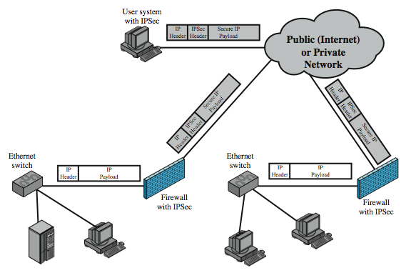
Virtual Private Networks
Notes:
In today's distributed computing environment, the virtual private network (VPN) offers an attractive solution to network managers. The VPN consists of a set of computers that interconnect by means of a relatively unsecure network and that make use of encryption and special protocols to provide security. At each corporate site, workstations, servers, and databases are linked by one or more local area networks (LANs). The Internet or some other public network can be used to interconnect sites, providing a cost savings over the use of a private network and offloading the wide area network management task to the public network provider. That same public network provides an access path for telecommuters and other mobile employees to log on to corporate systems from remote sites.
A logical means of implementing an IPSec is in a firewall, as shown in Stallings Figure 22.4, which essentially repeats Figure 19.1. If IPSec is implemented in a separate box behind (internal to) the firewall, then VPN traffic passing through the firewall in both directions is encrypted. In this case, the firewall is unable to perform its filtering function or other security functions, such as access control, logging, or scanning for viruses. IPSec could be implemented in the boundary router, outside the firewall. However, this device is likely to be less secure than the firewall and thus less desirable as an IPSec platform.

Slide 30
Virtual Private Networks
In today's distributed computing environment, the virtual private network (VPN) offers an attractive solution to network managers. The VPN consists of a set of computers that interconnect by means of a relatively unsecure network and that make use of encryption and special protocols to provide security. At each corporate site, workstations, servers, and databases are linked by one or more local area networks (LANs).
The Internet or some other public network can be used to interconnect sites, providing a cost savings over the use of a private network and offloading the wide area network management task to the public network provider. That same public network provides an access path for telecommuters and other mobile employees to log on to corporate systems from remote sites. boundary router, outside the firewall.
If IPSec is implemented in a separate box behind (internal to) the firewall, then VPN traffic passing through the firewall in both directions is encrypted. In this case, the firewall is unable to perform its filtering function or other security functions, such as access control, logging, or scanning for viruses

Slide 31
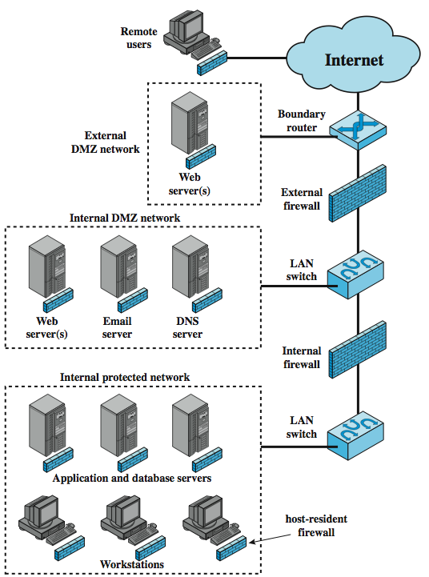
Distributed Firewalls
Notes:
A distributed firewall configuration involves stand-alone firewall devices plus host-based firewalls working together under a central administrative control. Stallings Figure 22.5 suggests a distributed firewall configuration. Administrators can configure host-resident firewalls on hundreds of servers and workstation as well as configure personal firewalls on local and remote user systems. Tools let the network administrator set policies and monitor security across the entire network. These firewalls protect against internal attacks and provide protection tailored to specific machines and applications. Stand-alone firewalls provide global protection, including internal firewalls and an external firewall, as discussed previously. With distributed firewalls, it may make sense to establish both an internal and an external DMZ. Web servers that need less protection because they have less critical information on them could be placed in an external DMZ, outside the external firewall. What protection is needed is provided by host-based firewalls on these servers. An important aspect of a distributed firewall configuration is security monitoring. Such monitoring typically includes log aggregation and analysis, firewall statistics, and fine-grained remote monitoring of individual hosts if needed.

Slide 32
A distributed firewall configuration involves stand-alone firewall devices plus host-based firewalls working together under a central administrative control
Administrators can configure host-resident firewalls on hundreds of servers and workstation as well as configure personal firewalls on local and remote user systems.
Tools let the network administrator set policies and monitor security across the entire network. These firewalls protect against internal attacks and provide protection tailored to specific machines and applications. Stand-alone firewalls provide global protection, including internal firewalls and an external firewall.
With distributed firewalls, it may make sense to establish both an internal and an external DMZ. Web servers that need less protection because they have less critical information on them could be placed in an external DMZ, outside the external firewall. What protection is needed is provided by host-based firewalls on these servers.

Slide 33
Intrusion
Intrusion: A purposeful and unauthorized effort to gain access to or manipulate information or systems, with the intention of making them unreliable or unusable.
Misuse: Refers to suspicious activities originating from within the internal network, which can also be categorized as unauthorized or inappropriate use.

Slide 34
Intrusion Detection
Intrusion detection: The process of monitoring computer system or network events and analyzing them to identify potential incidents. These incidents can involve violations or imminent threats of violation to computer security policies, acceptable use policies, or standard security practices.
Causes of incidents:
  Malware: Examples include worms and spyware.
  Unauthorized access by attackers from the Internet.
  Misuse of privileges by authorized system users, including attempts to gain unauthorized additional privileges.
Incidents may not always be malicious:
  Mistyping the address of a computer, leading to an accidental attempt to connect to a different system without authorization.

Slide 35
Intrusion Detection System
Intrusion Detection System (IDS): Software that automates the process of intrusion detection.
Intrusion Prevention System (IPS): Software that includes all the capabilities of an IDS and can also attempt to prevent potential incidents.
IDS and IPS technologies share many capabilities, and administrators can typically disable prevention features in IPS products to utilize them as IDSs.
To simplify terminology, the term Intrusion Detection and Prevention Systems (IDPS) will be used throughout the presentation to refer to both IDS and IPS technologies.

Slide 36
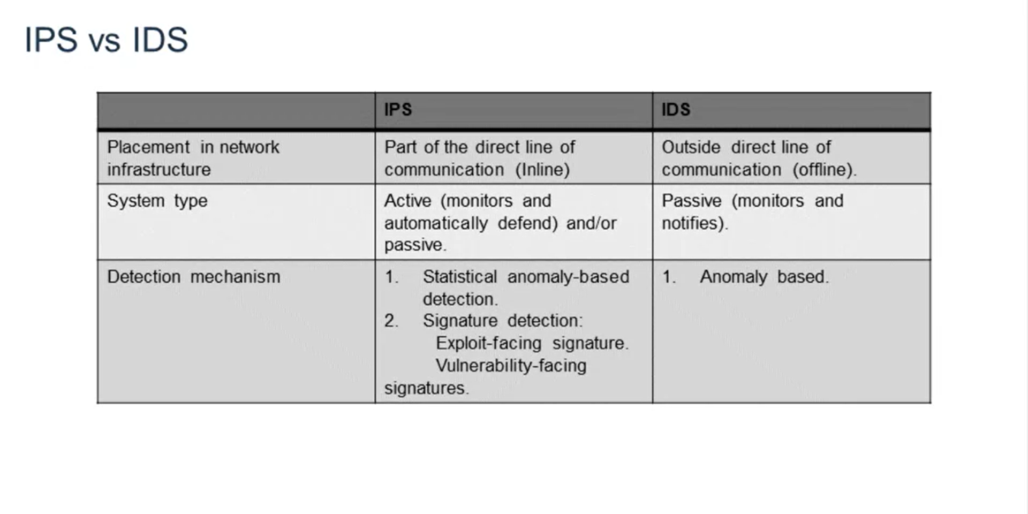

Slide 37
Why to use IDPS?
Primary purpose: Detecting potential incidents.
Reporting incidents to Security Administrators.
Recognizing violations of security policies.
Identifying network traffic violations based on the organization's security policy.
Monitoring files and identifying suspicious ones.
Recognizing reconnaissance activities as indicators of an imminent attack.
  Conducting host or port scans to identify targets for future attacks.
Blocking reconnaissance activities.
Notes:
Reconnaissance refers to the preliminary phase of an attack or intrusion, where an attacker gathers information about a target system or network. It involves activities such as scanning for vulnerabilities, identifying potential entry points, mapping the network infrastructure, and gathering intelligence about the target's security measures. The purpose of reconnaissance is to gather information that will aid in planning and executing a successful attack or intrusion.

Slide 38
IDS & IPS – Where they differ?
IPS technologies are differentiated from IDS technologies by one characteristic – IPS response techniques:
  Stopping the attack:
    Terminating the network connection or user session associated with the attack.
    Blocking access to the target or potential targets based on the offending user account, IP address, or other attacker attributes.
    Blocking all access to the targeted host, service, application, or resource.
  Changing the security environment:
    Modifying the configuration of other security controls, such as network devices (firewalls, routers, switches), to disrupt the attack.
    Some IPSs can trigger the application of patches to vulnerable hosts.
  Modifying the attack's content:
    Certain IPS technologies can remove or replace malicious components of an attack to neutralize its impact.
    For instance, an IPS can remove an infected file attachment from an email, allowing the cleaned email to reach its intended recipient.

Slide 39
Who is Intruder?
Masquerader: An unauthorized individual who breaches a system's access controls to exploit a legitimate user's account. Considered an outsider.
Misfeasor: A legitimate user who accesses data, programs, or resources without authorization or misuses their authorized privileges. Considered an insider.
Clandestine user: An individual who takes control of the system at a supervisory level, evading auditing and access controls or suppressing audit collection. This can be either an insider or an outsider.
Notes:
Clandestine – kept secret or done secretively, especially because illicit.

Slide 40
Intruder Behavior
Cracker:
  Motivated by the thrill of access and/or status.
  Seeks open targets and may share information with others.
  Exploits security flaws in software to gain unauthorized access.
  Considers IDS and IPS systems highly useful.
Criminal Enterprise:
  Motivated by financial rewards and/or political/religious ideologies.
  Comprised of corporations, government-funded entities, or gangs.
  Targets specific entities and avoids publicity.
  Utilizes security flaws and social engineering techniques to gain access.
  Recognizes the usefulness of IDS and IPS systems.
Internal Threat:
  Motivated by revenge and/or a sense of entitlement.
  Has legitimate access to the system, making detection difficult.
  Internal security mechanisms such as least privilege, strong authentication, logging, auditing, and employee termination policies are useful in mitigating risks.

Slide 41
Intrusion Techniques
Scanning/Mapping:
  Network Mapping: Determining the physical connectivity of networks.
  Network Enumerating: Gathering information about a specific machine.
  Port scanning/Probing vulnerabilities: Investigating open ports and searching for potential vulnerabilities.
Denial of Service attacks (DoS/DDoS):
  Ping Of Death: Sending ICMP echo packets with payloads exceeding the maximum limit (65K).
  Neptune (SYN FLOOD): Flooding the target with SYN packets to exhaust system resources.
  Land Attack: Sending a TCP SYN packet with the source IP address set to the target's IP, causing the system to reboot.
  Process Table Attack: Similar to SYN flood, exploiting open connections in Linux.
  Smurf Attack: Flooding the victim machine with a large volume of ping requests.
Gaining Access:
  Password Guessing: Attempting to guess passwords using methods like dictionary attacks or default passwords.
  TCP Hijacking: Involving in the initiation of a TCP session and taking control of it.
  Use of agents for destructive purposes: Employing agents to act on behalf of the attacker in order to harm the target.

Slide 42
Network-based Intrusion Detection Systems (NIDS)
Network-based Intrusion Detection System (NIDS):
Detects malicious traffic on a network.
Requires promiscuous network access to analyze all traffic, including unicast traffic.
Operates passively without interfering with monitored traffic.
Typical NIDS architecture involves sniffing the internal interface of the firewall in read-only mode.
Sends alerts to a NIDS Management server via a separate read/write network interface.
Inline sensor:
  Inserted into the network to analyze traffic as it passes through the sensor.
  Operates as software on existing switches, routers, or firewalls, requiring no additional hardware.
  Capable of preventing an attack immediately upon detection.
Passive sensor:
  Monitors a copy of network traffic.
  Requires an additional device, such as a switch port mirroring setup, to receive the copy of traffic.
  Has minimal impact on the performance of the actual traffic being monitored.

Slide 43
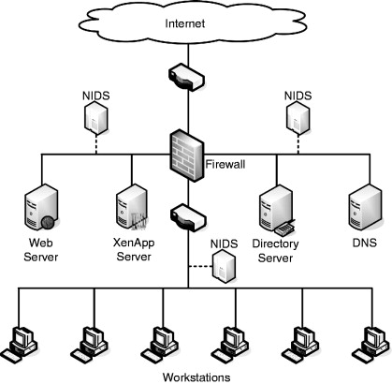
Network-based Intrusion Detection Systems (NIDS)

Slide 44
Host-based Intrusion Detection Systems (HIDS)
HIDS differ from NIDS in two ways.
  HIDS protects only the host system where it is installed.
  HIDS operates its network card in non-promiscuous mode (a network interface controller (NIC) setting where the NIC only processes and receives packets addressed to its specific MAC address or broadcast/multicast packets), which has advantages such as compatibility with NICs that lack promiscuous mode and lower CPU usage on slower host machines.
  Additionally, HIDS can be installed directly on the firewall to enhance its security.
Tailored ruleset and enhanced performance:
  HIDS allows customization of the ruleset based on specific needs.
  Unnecessary rules, such as those detecting DNS exploits for hosts without running Domain Name Services, can be excluded.
  This reduction in pertinent rules improves performance and reduces processor overhead.
Notes:
Non-Promiscuous Mode: When the NIC receives a frame, it drops it unless it is addressed to its specific media access control address or is a broadcast or multicast addressed frame.

Slide 45
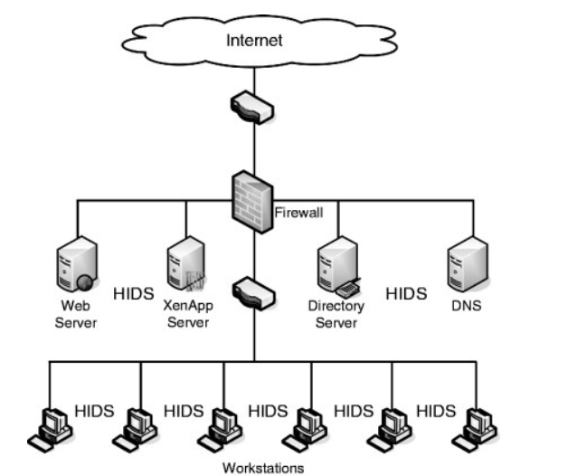
Host-based Intrusion Detection Systems (HIDS)

Slide 46
Distributed Host-Based Intrusion Detection Systems
Host-based IDS on organizational LAN or internetwork:
  Host agents installed on individual hosts collect and analyze audit records.
  LAN monitor agent analyzes LAN traffic.
  Host and LAN monitor agents send alerts to a central manager.
  Central manager combines data from agents to detect intrusions and may request specific host data.
Issues:
  Dealing with different audit record formats.
  Ensuring secure transmission of data over the network by agents.
  Central architecture poses a single point of failure.
  Distributed architecture requires complex coordination.

Slide 47
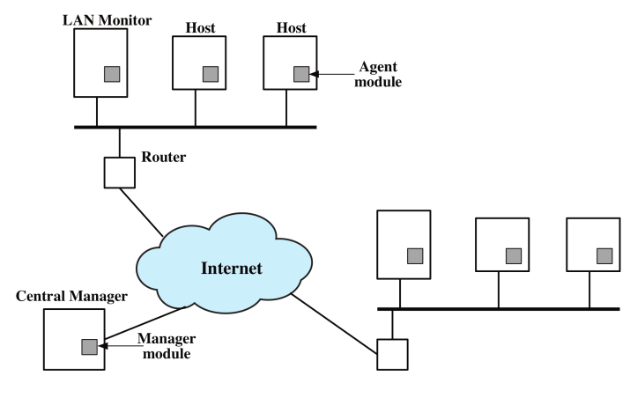
Distributed Host-Based Intrusion Detection Systems
Notes:
Non-Promiscuous Mode: When the NIC receives a frame, it drops it unless it is addressed to its specific media access control address or is a broadcast or multicast addressed frame.

Slide 48
Detection Methodologies: Signature based Detection
Signature Detection:
  Defines behavior or attacks using a set of rules or patterns.
  Compares observed behavior against these rules/patterns.
  Rule-based anomaly detection: Defines rules based on past observed normal behavior.
  Rule-based penetration identification: Defines rules based on known attack patterns.

Slide 49
Detection Methodologies: Anomaly based Detection
Anomaly Detection:
  Compares observed behavior with previously collected normal behavior.
  Threshold detection: Sets thresholds based on the frequency of event occurrences, regardless of the user.
  Profile-based: Creates and compares user profiles against the observed behavior.

Slide 50
Honeypots
Decoy systems designed to divert potential attackers away from critical systems.
Collect information about the attacker's activities and methods.
Encourage the attacker to remain on the system long enough for administrators to respond.
Filled with fabricated information that wouldn't be accessed by legitimate users.
Honeypots have no production value and serve as a resource for monitoring and analysis.
Incoming communication to a honeypot is likely a probe, scan, or attack.
Outbound communication from a honeypot indicates that the system has likely been compromised.
Administrators can observe the intruders' behavior within the honeypot to better understand their tactics and develop defensive measures.

Slide 51
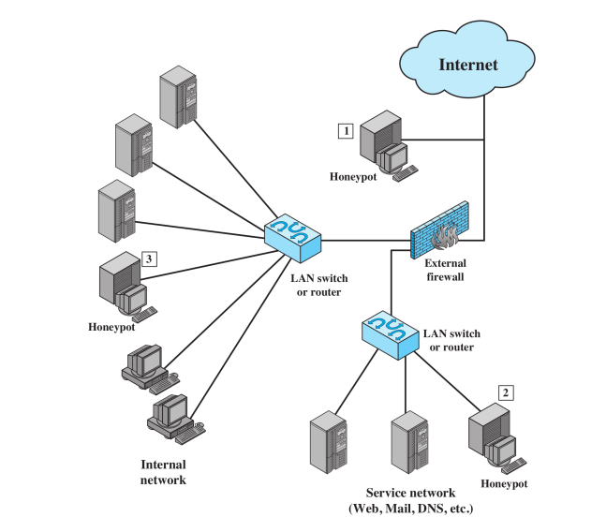
Honeypots Deployment

Slide 52
Summary
Intruders:
  Intruders can be insiders (within the organization) or outsiders.
  Their goal is to gain access to a system or increase their privileges on a system.
  They exploit software vulnerabilities to acquire protected information.
Intrusion detection:
  Its objective is to differentiate between normal behavior and the behavior of an intruder.
  It looks for anomalies or patterns that indicate potential intrusions.
  Data collection is performed from one or more hosts or network devices.
Intrusion prevention:
  Complements intrusion detection systems.
  Actively responds to detected threats to prevent intrusions.
  Stops attacks by terminating connections, blocking access, or modifying the security environment.
  Some systems can remove or replace malicious components of an attack.
  Provides an additional layer of defense to enhance overall security.

